Slide 1
Multimedia and the Web
Prepared by:
Aju Manandhar
Ayush Ghimire
Bibekananda Chaudhary
Bidhan Maharjan

Slide 2
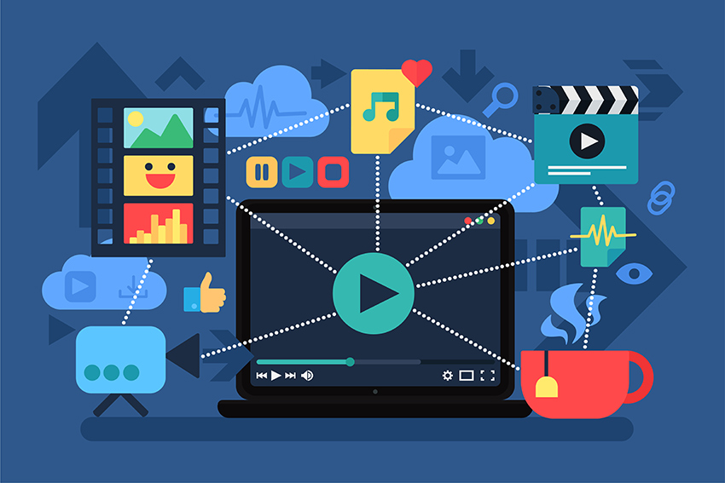
Introduction of Multimedia
Combines different form of text, audio, images, animation or video,
Representation of information in an attractive and interactive manner,
Examples of multimedia include video podcasts, audio slideshows and animated videos.

Slide 3
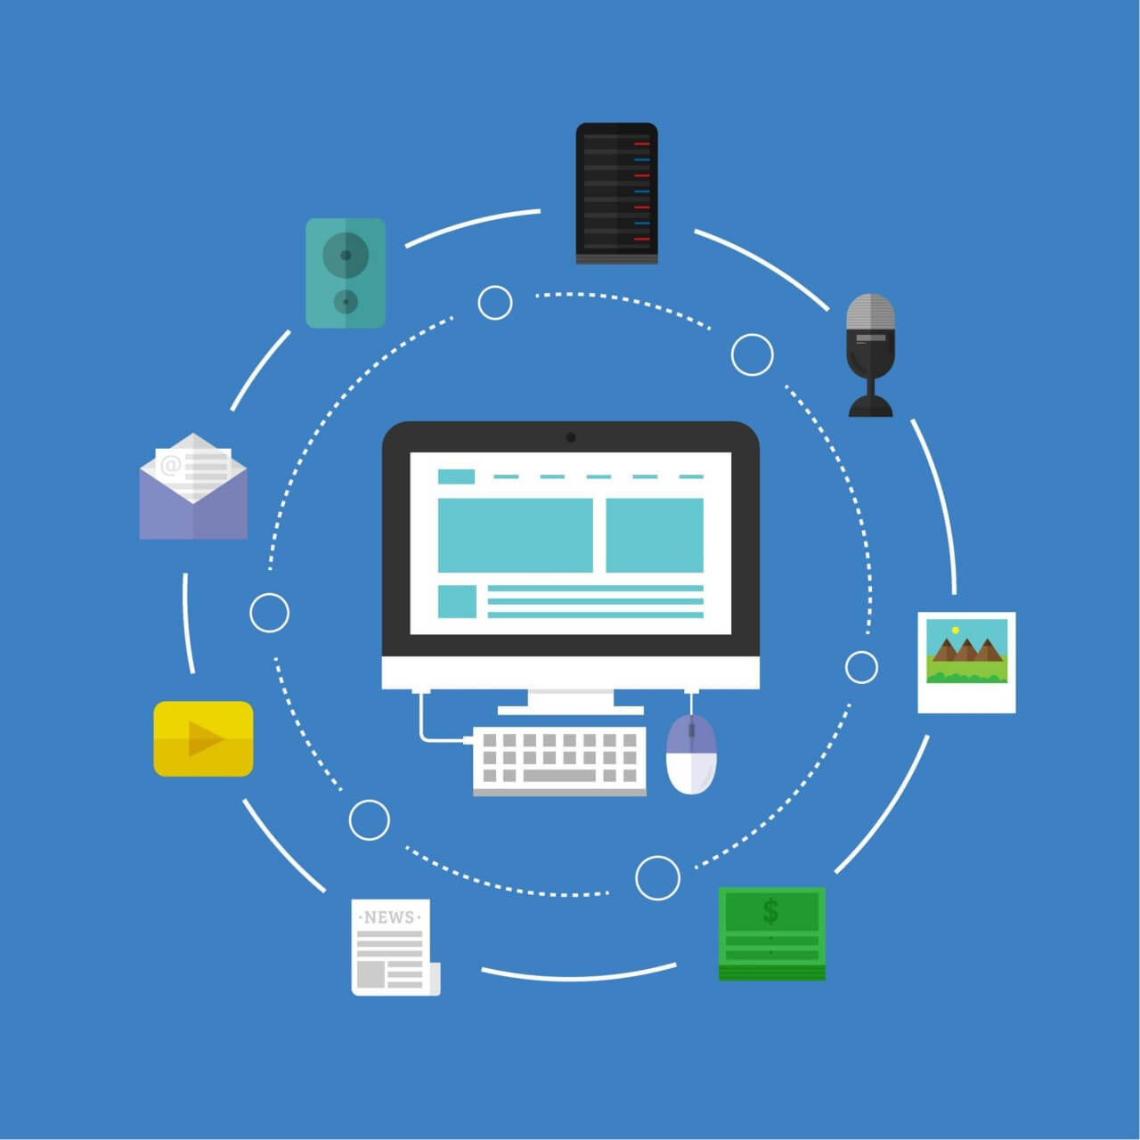
Elements of multimedia
Text
Audio
Video
Animation
Images

Slide 4
I. Text
Is an important component used in many multimedia applications,
Are characters that are used to create words, sentences and paragraphs,
Provides just one source of information.

Slide 5
II. Audio
Multimedia application may require the use of speech, music and sound effects
These are called audio or sound element of multimedia,
Are of analog and digital types.

Slide 6
III. Video
Refers to the moving picture, accompanied by sound such as a picture in television,
Gives a lot of information in small duration of time,
Is useful in multimedia application for showing real life objects.

Slide 7
IV. Animation
The process of designing, drawing, making layouts and preparation of photographic sequences,
Are integrated in the multimedia and gaming products,
Involves the exploitation and management of still images to generate the illusion of movement.

Slide 8
V. Images
Is a visual representation of something that has been created or copied and stored in electronic form,
Consists of a rectangular array of dots called pixels,
Image is specified in terms of width X height, in numbers of the pixels.

Slide 9

Graphics
Are visual images on some surface, such as a wall, canvas, to inform or entertain,
Includes a pictorial representation of data, as in design,
Graphics combine text, illustration, and color.

Slide 10
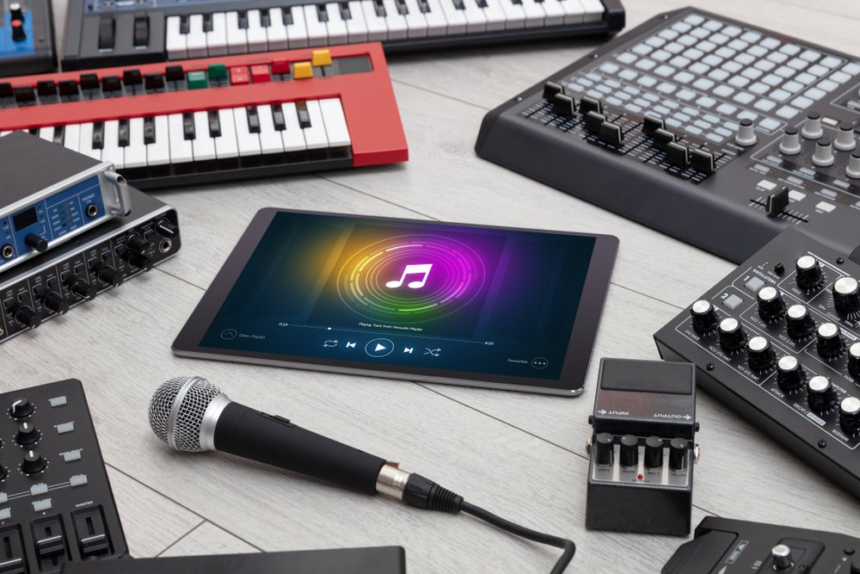
Sound
Sequence of naturally analog signals that are converted to digital signals,
Used to participate in online activities such as video conference,
Used by people to create or use multimedia products, watch

Slide 11
Image File Format
Are standardized means of organizing and storing digital images,
May store data in an uncompressed format, a compressed format ,or a vector format,
The common image file formats are:
I . GIF
ii . JPEG
iii . PNG
iv . TIFF

Slide 12
i. GIF
Graphics Interchange Format(GIF) files are widely used for web graphics,
Are limited to only 256 colors,
Can allow for transparency, and can be animated,
Are typically small is size and are very portable.

Slide 13
ii. JPEG
Stands for Joint Photographic Experts Groups,
Is a “lossy” format meaning that the image is compressed to make a smaller file,
Very common on the Internet,
Popular format for digital cameras.

Slide 14
iii. PNG
Stands for Portable Network Graphics,
Designed to improve upon and replace the gif format,
Are able to handle up to 16 million colors,
Is best for Web Images.

Slide 15
Web -Based Multimedia
Term used to describe(sound, video, animation, text and images)
Contains sound, video, animation located on Web pages

Slide 16
Future of Web Based Multimedia
Media formats such as ultra-high-definition, high frame rate, high dynamic range,
Optimizing the quality of real-time multimedia application,
Media processing within the cloud,
Device and interaction possibilities,

Slide 17
Multimedia in Business
Used to communicate and business audience,
Combines multiple text, audio, videos,
Include training, marketing, advertising, and product demos,
Evolve challenges and opportunities.

Slide 18
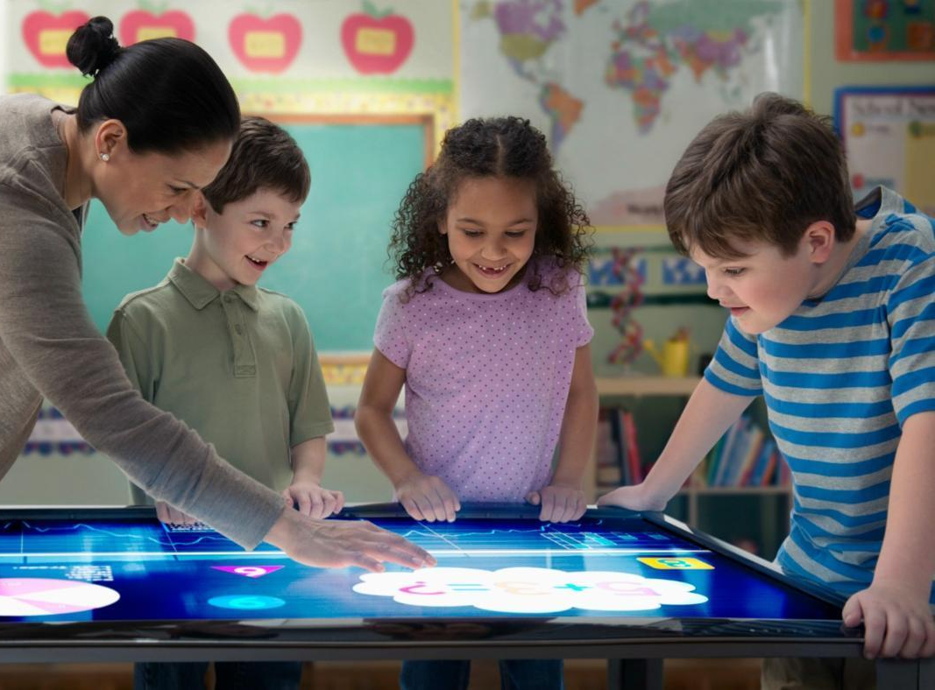
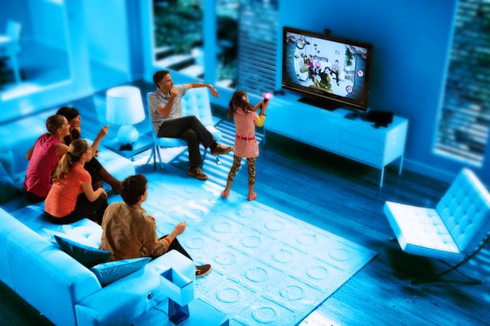
Application of multimedia
Creative Industries
Commercial Uses
Education
Health and Medical

Slide 19
I. Creative Industries
Use multimedia for a variety of purposes ranging from fine arts, to entertainment, to commercial art, to journalism, to media and software services,
Examples of this type of work is used in video games, information kiosks, websites and other interactive applications,
Used for effective presentation.

Slide 20
II. Commercial Uses
Multimedia applications for business include training, marketing, advertising, and product demos,
Multimedia are essential in sales, training, teaching, and entertaining,
Presenting allows us to speak in front of people and present our products or projects.

Slide 21
III. Education
Through participation in multimedia activities, students can learn real-world skills related to technology,
Multimedia is use to produce computer based training course called Computer Based Training courses (CBT),
It helps to make teaching/learning more lively.

Slide 22
IV. Health and Medical
Doctors can get trained by looking at virtual surgeries,
Can simulate how human body is affected by diseases and then develop technique to prevent it,
Multimedia are useful for people with medical informatics, rehabilitation and assistive & preventive healthcare.

Slide 23
Advantages
Increases learning effectiveness
More appealing over traditional
Improves personal Communication
Provides high Quality of Presentations
User Friendly
23

Slide 24
Disadvantages
Misuse of Multimedia
Lost in cyberspace
Non Interactive
Time consuming
24

Slide 25


